Slide 1

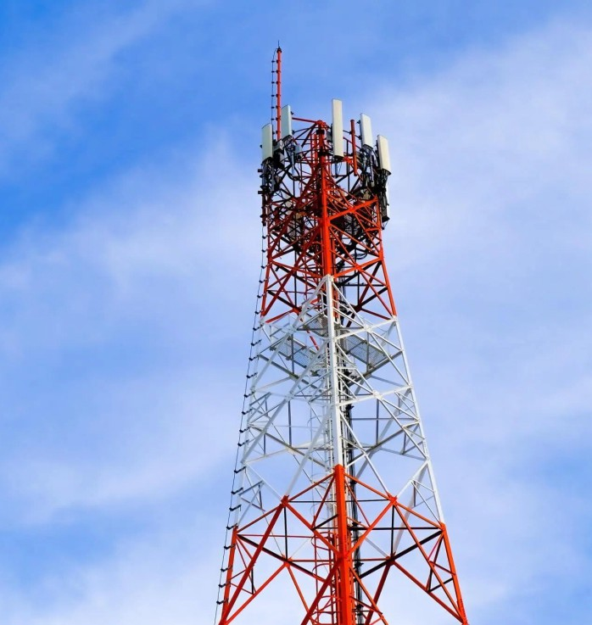
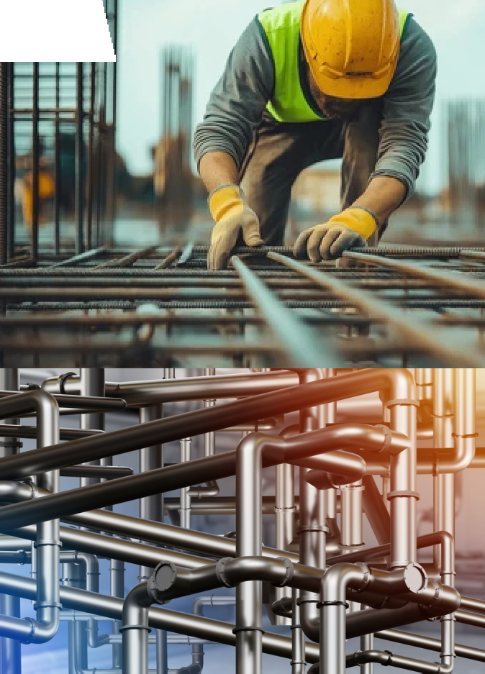
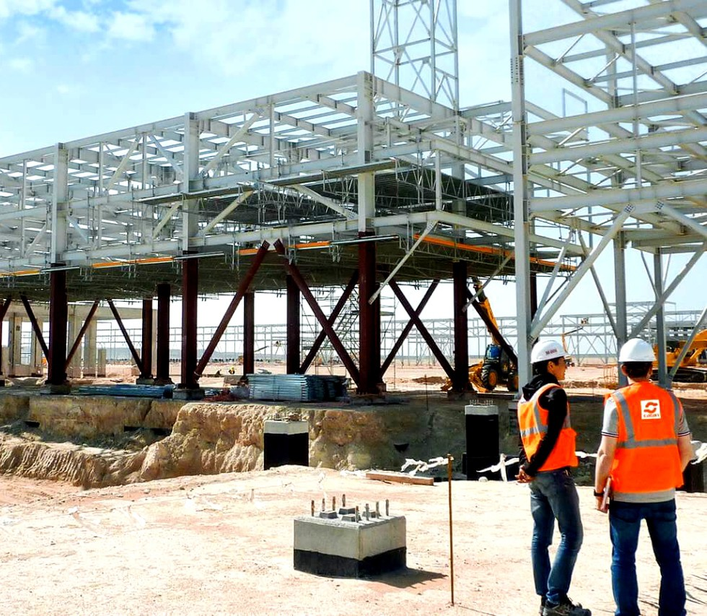
SDG INFRATECH PVT. LTD.
"Your partner in sales Success”

Slide 2


SDG INFRATECH PVT. LTD. (COMPANY PROFILE)
Company Overview
SDG Infratech Pvt. Ltd. is a dynamic industrial goods supplier and integrated service provider Headquarter in Faridabad (Haryana) INDIA dedicated to meeting the diverse needs of manufacturers, contractors, and infrastructure projects across India. With a relentless focus on quality, reliability and innovation, we bridge the gap between procurement challenges and operational success—delivering the right products, the right services, every time.
Our Mission
To empower industries with top-tier equipment, components and services that drive productivity and safety.
To build lasting partnerships by delivering consistent value, transparent communication and unmatched responsiveness.
To foster a culture of continuous improvement, leveraging technology and best practices to exceed client expectations.

Slide 3
Our Vision
To be recognized as India’s foremost one-stop industrial solutions partner where quality, speed and customer care converge.
To expand our reach into emerging sectors and geographies, supporting sustainable infrastructure development nationwide.
Core Values
Integrity : We operate ethically, honoring commitments and fostering trust at every level.
Excellence : We relentlessly pursue the highest standards in product selection, service delivery and customer support.
Agility : We respond swiftly to market demands, adapting our offerings to evolving industrial trends.
Collaboration: We build strong, transparent relationships with suppliers, partners and clients.
Safety & Sustainability : We promote eco-friendly practices and prioritize workplace safety in all our operations.

Slide 4

Our Products & Services
Industrial Equipment & Machinery :
Pipes & Fitting, Pumps, compressors, turbines, conveyors, hydraulic systems.
Mechanical Components :
Seals, bearings, gears, couplings, fasteners, Rubber gasKits,
Power Transmission
V-Belts, Change, Sprockets, Motors, Cables, Gearboxes, Switchgear and Variable frequency drives.
Bulk Materials & Consumables :
Lubricants, abrasives, welding supplies, ﬁltration media.
Installation & Commissioning :
End-to-end project management—from on-site assembly to performance validation.
Preventive Maintenance & Repair :
Scheduled inspections, condition monitoring, breakdown support.
Technical Consultancy :
Process optimization, custom engineering, value-analysis studies.
Supply-Chain Management :
Vendor development, inventory planning, JIT delivery solutions.

Slide 5


Why Choose SDG Infratech?
Comprehensive Portfolio :
A one-stop destination for all your industrial requirements.
Vendor Network :
Strategically partnered with leading global manufacturers for best-in-class products.
Quality Assurance :
Rigorously tested goods and certiﬁed processes ensure uptime and reliability.
24/7 Support :
Dedicated service teams and rapid response units minimize downtime.
Competitive Pricing :
Streamlined logistics and volume procurement translate into cost savings for you.
Quality & Compliance
At SDG Infratech, quality isn’t negotiable. We adhere to ISO-compliant procedures,
conduct routine audits and maintain strict supplier evaluation protocols. Our commitment to environmental regulations and safety standards underscores every project we undertake.

Slide 6

Our Team
Our diverse workforce brings together seasoned engineers, procurement specialists and project managers—all driven by a single goal: your success. Continuous training and knowledge-sharing keep our experts at the cutting edge of industrial innovation.
Let’s Build the Future Together
Whether you’re launching a greenﬁeld facility, upgrading existing assets or seeking turnkey maintenance solutions, SDG Infratech Pvt. Ltd. has the expertise, the products and the people to help you succeed. Contact us today to discuss your on going / next project.
Strategic Partnerships
We collaborated with leading equipment manufacturers, technology innovators and logistics providers to maintain our competitive edge and offer end-to-end solutions tailored to client objectives.
Client Industries
Automotive, Steel and metal fabrication, power generation, oil & gas construction, pharmaceuticals, food processing and logistics.

Slide 7

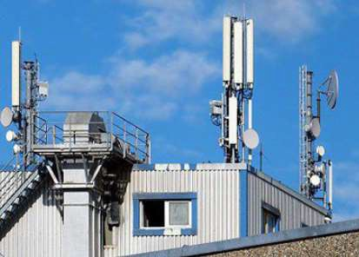
IBS Services For Telecom
IBS Implementation Process
Choosing material types for IBS
Designing the Implementation model
Ensuring feasibility of the prepared project
Verification of elements as per drawings/layouts
BTS Installation
BTS installation as per the approved designing
Ensuring efficient connectivity with DAS with BTS
Site Optimization
Signal status verification on each portion of the building
Ensuring proper implementation of DAS as per the design requirements
Site Approval
Pre-acceptance of site after finishing the work
Final assessment
Post-acceptance test after work main work completion with main customer/vendor
Troubleshooting of issues with the design owner.
Ensuring proper coverage on every portion of the building
Acquiring necessary approvals from building owners and authorities
Coordination between vendor, operator and customer

Slide 8
Geographical Presence
(Project Based)
Madhya Pradesh
∗ Chhattisgarh
Bihar
Jharkhand
West Bengal
UP (E)
Orissa
Jammu & Kashmir
∗ Himachal Pradesh
Punjab
Haryana
New Delhi
Rajasthan
Mumbai

Slide 9






CUSTOMER REFERENCES

