Slide 1
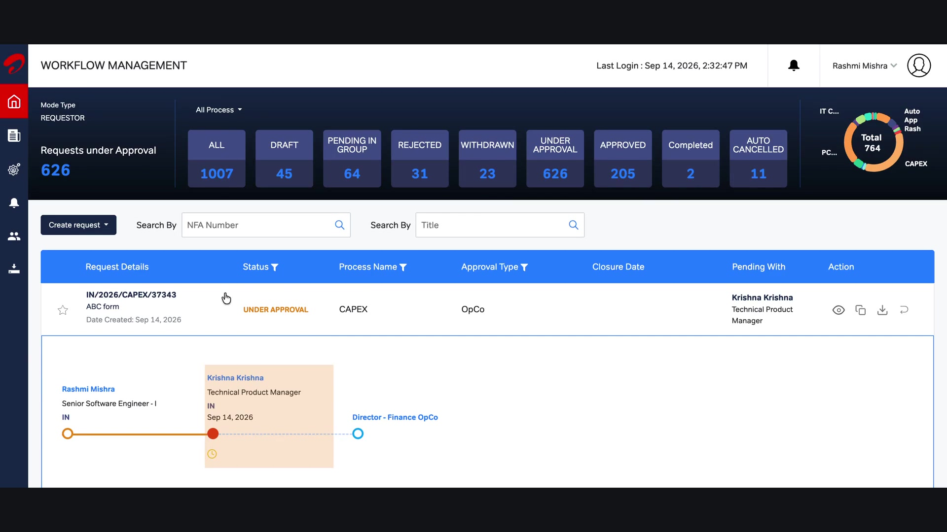
Login / Dashboard

Slide 2

Ticket Status

Slide 3

Replyback

Slide 4
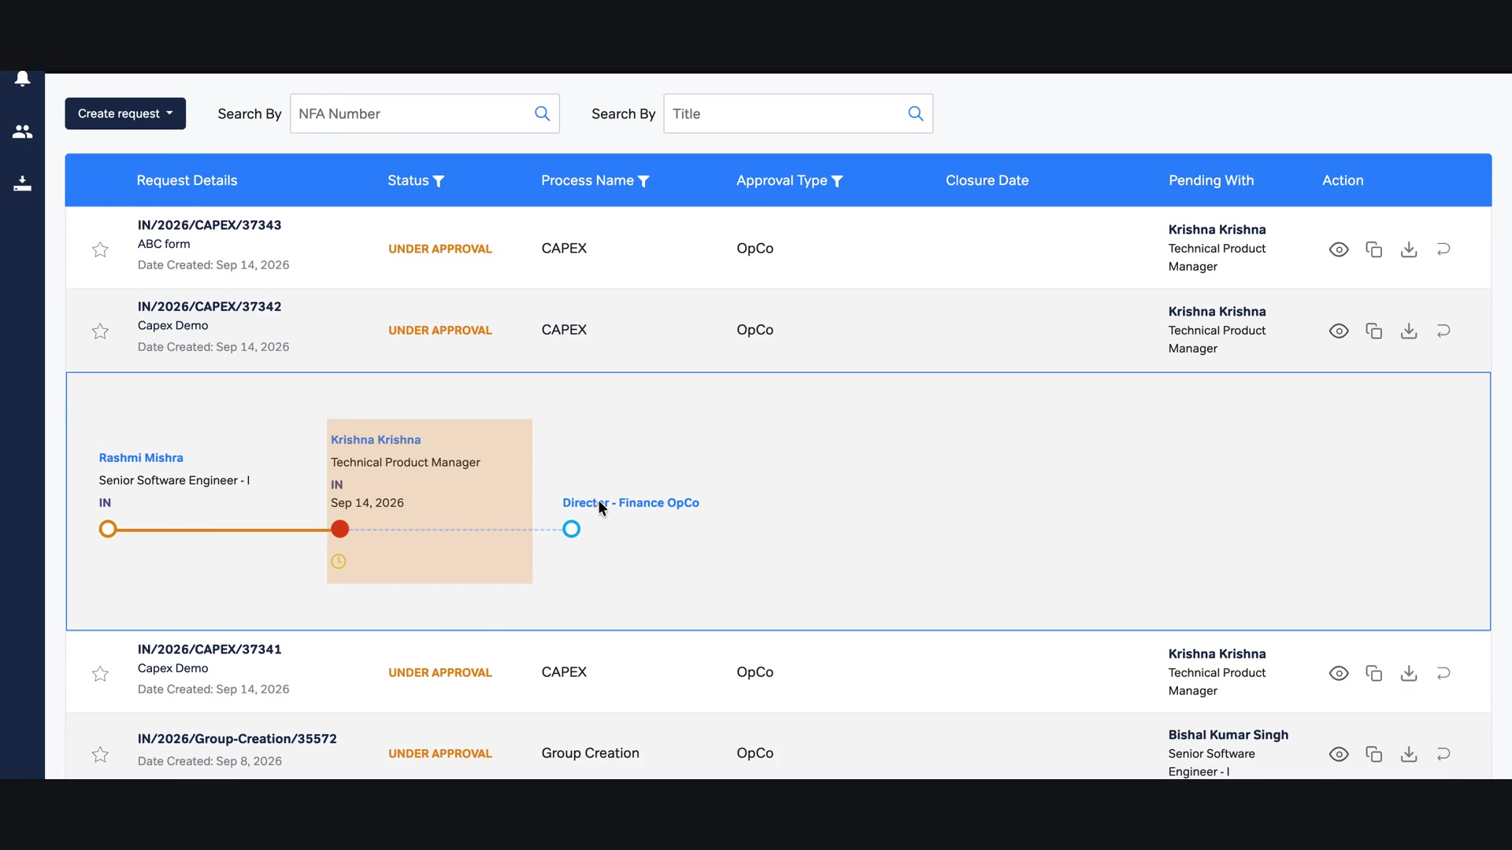
Download Attachment / Form

Slide 5
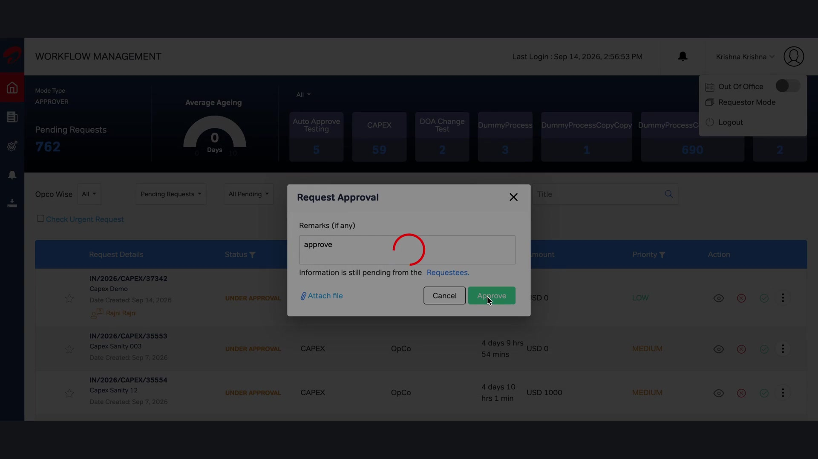
1–2 Approvers

Slide 6
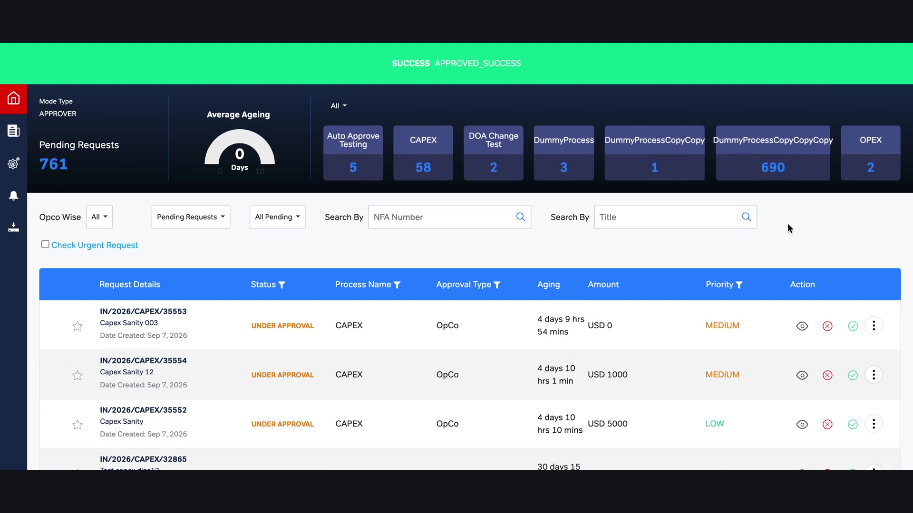
Approval Hierarchy

Slide 7
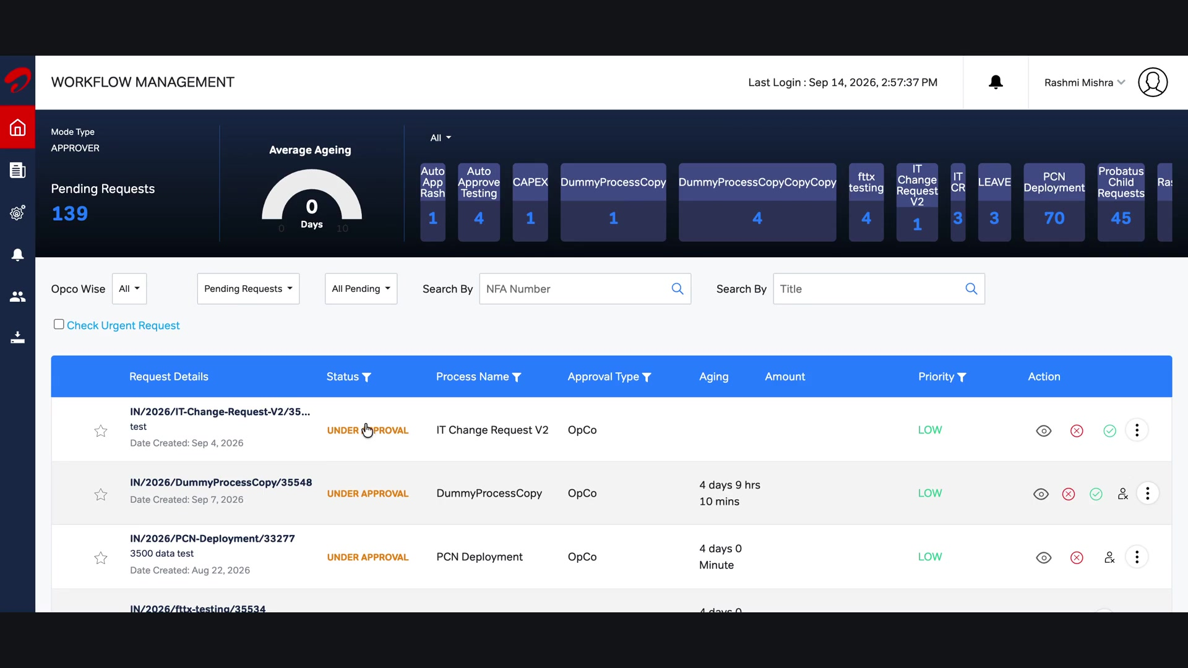
Referback / Delegate / Adhoc Approver

Slide 8
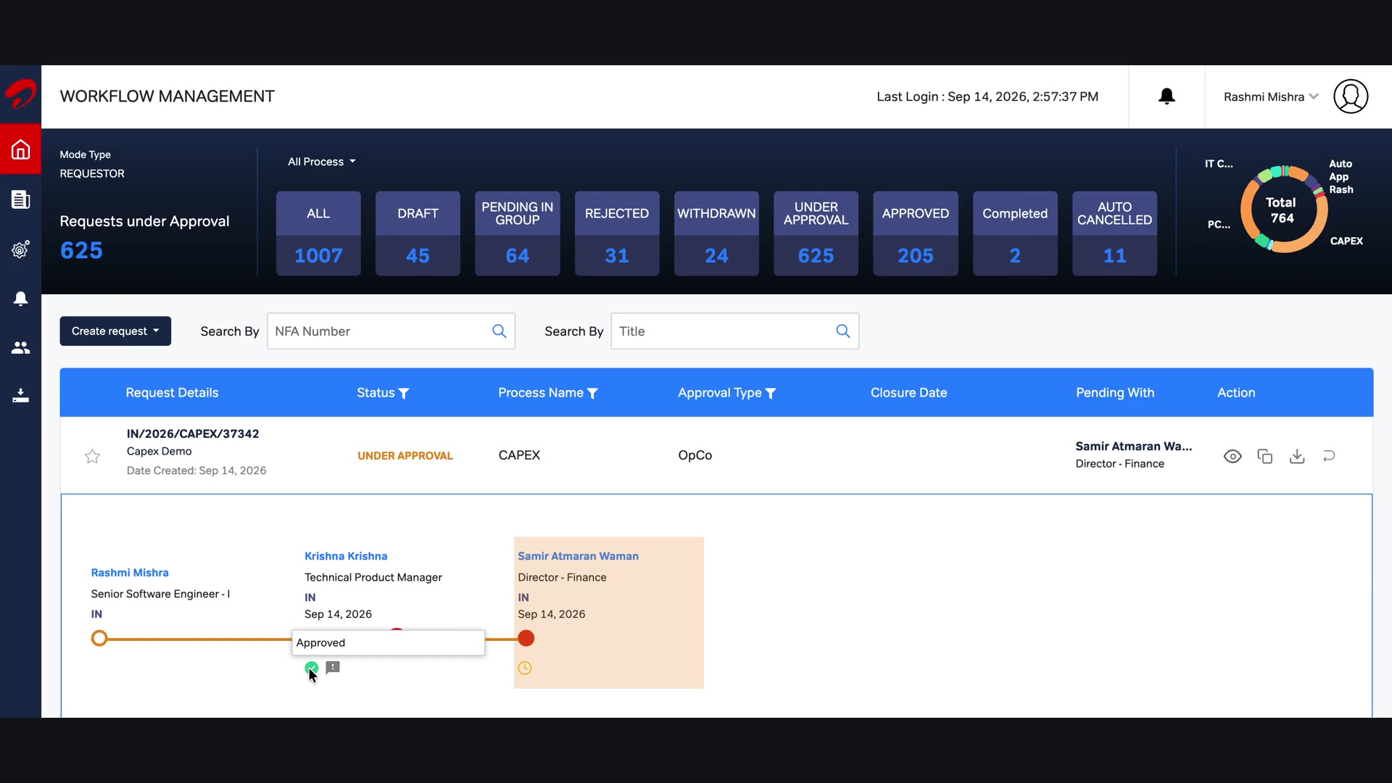
Request Information

Slide 9
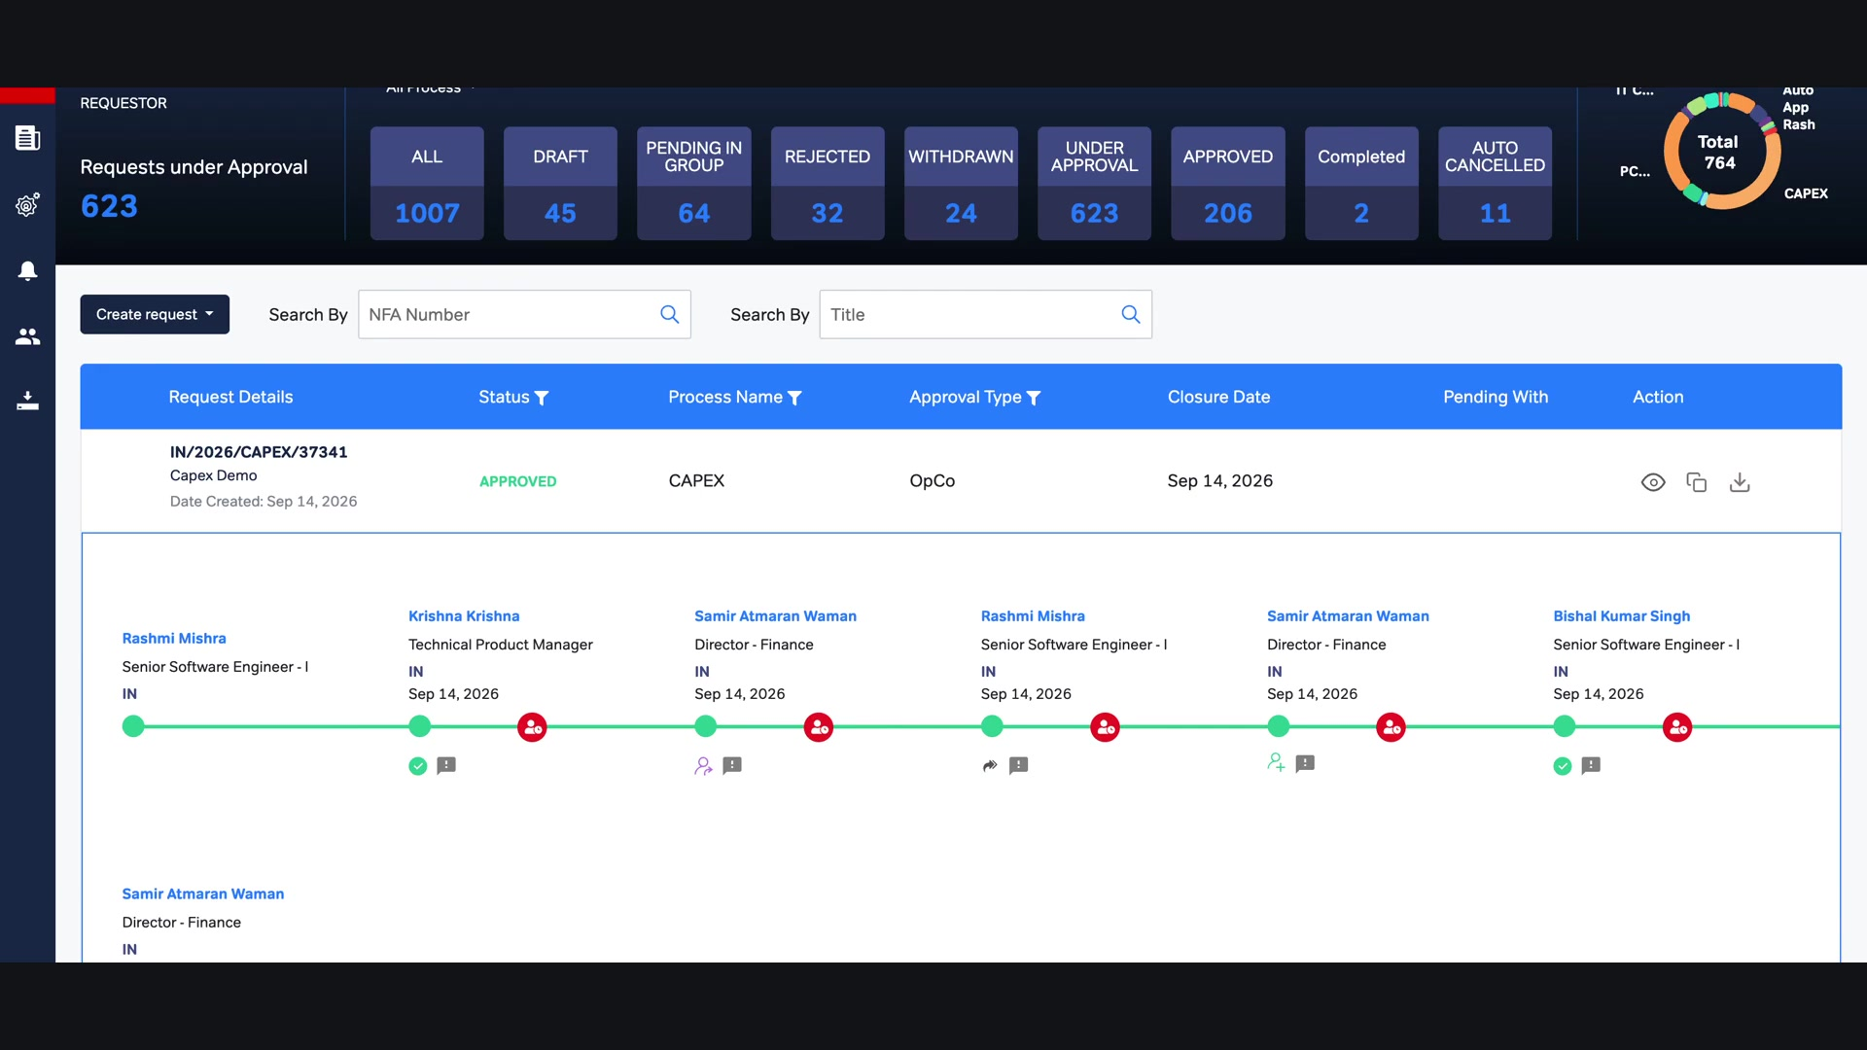
Approval Over Email

Slide 10
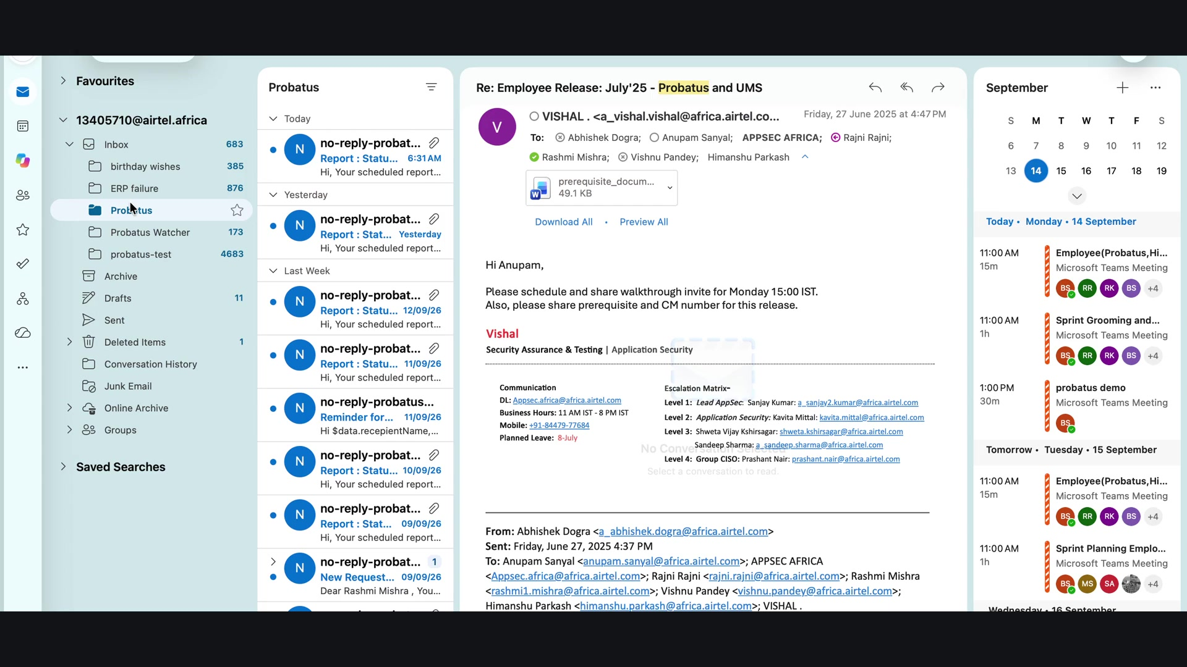
Email Approval Review

Slide 11
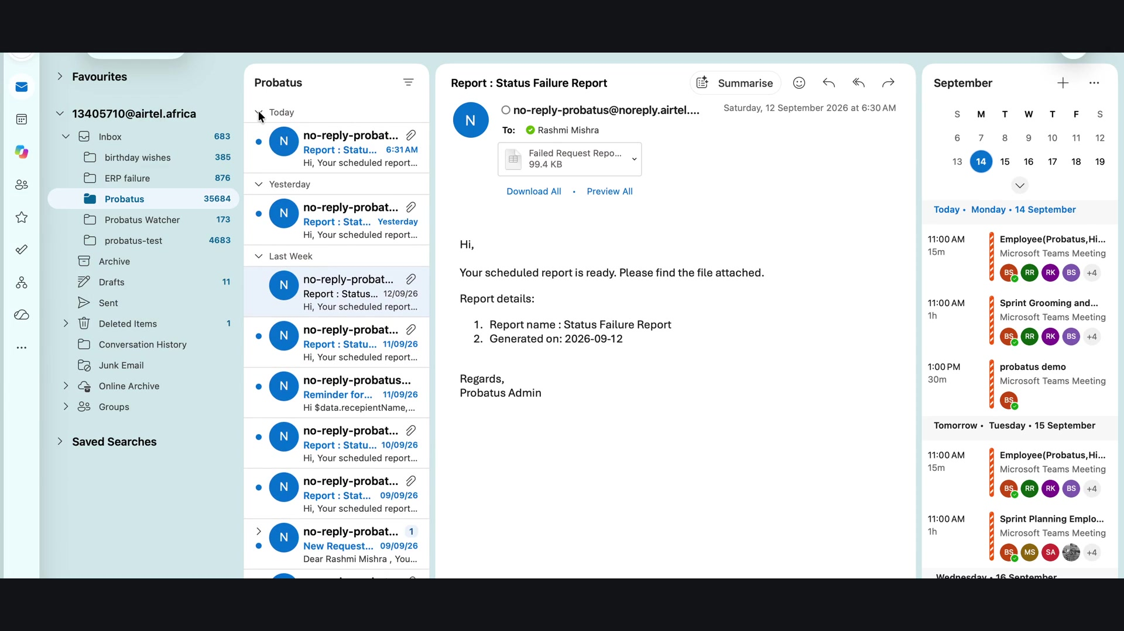
Email Approval

Slide 12
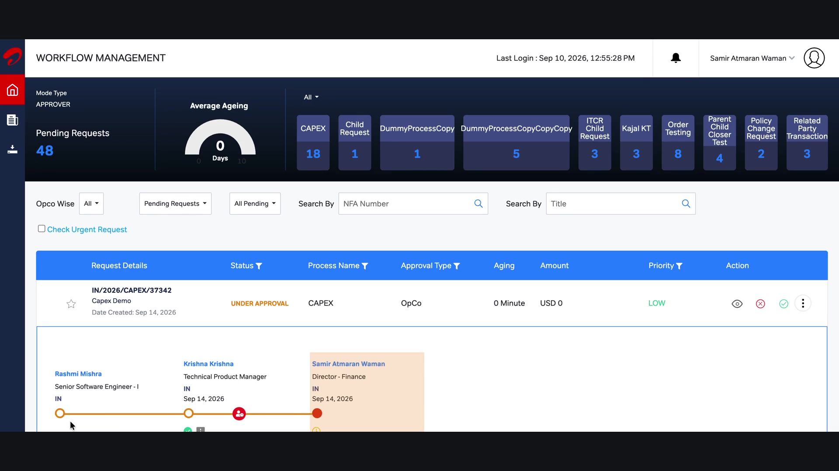
Out of Office

Slide 13
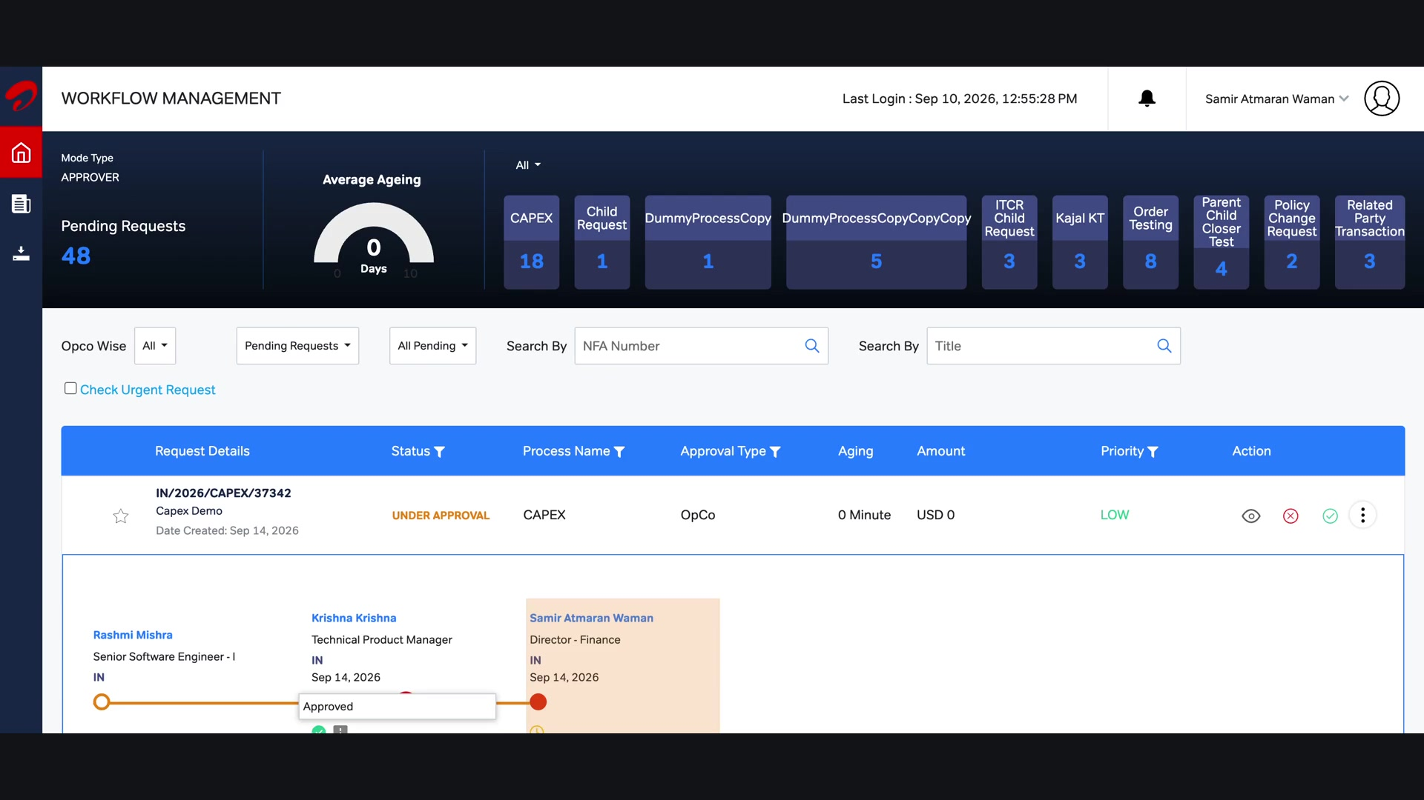
Child CRs

Slide 14
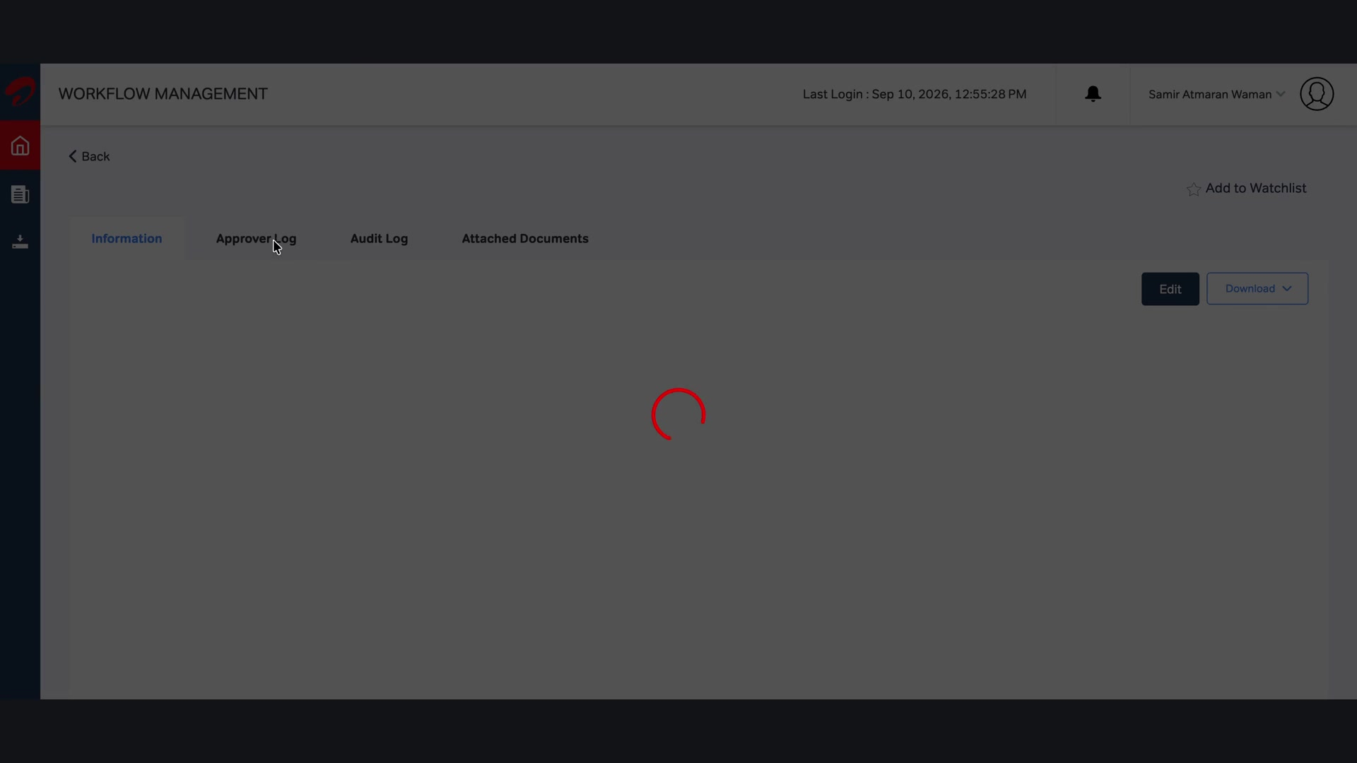
Fully Approved

Slide 15

Search

Slide 16

Approver-wise Details

Slide 17

Custom Field Report

Slide 18

Normal Report

Slide 19
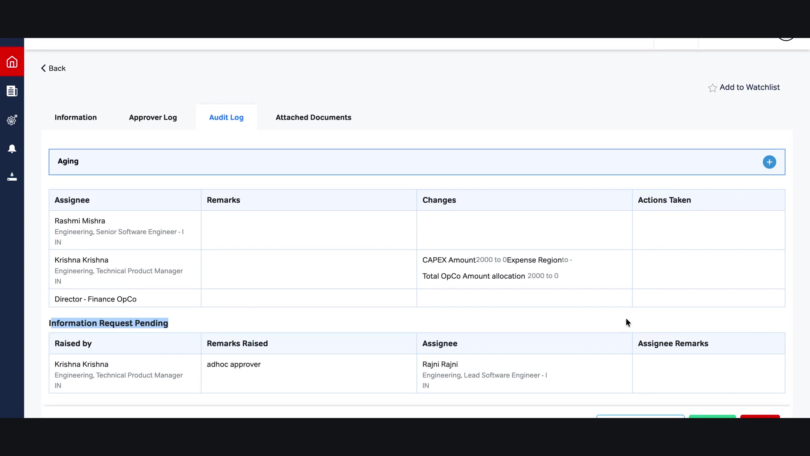
Currency Management

Slide 20
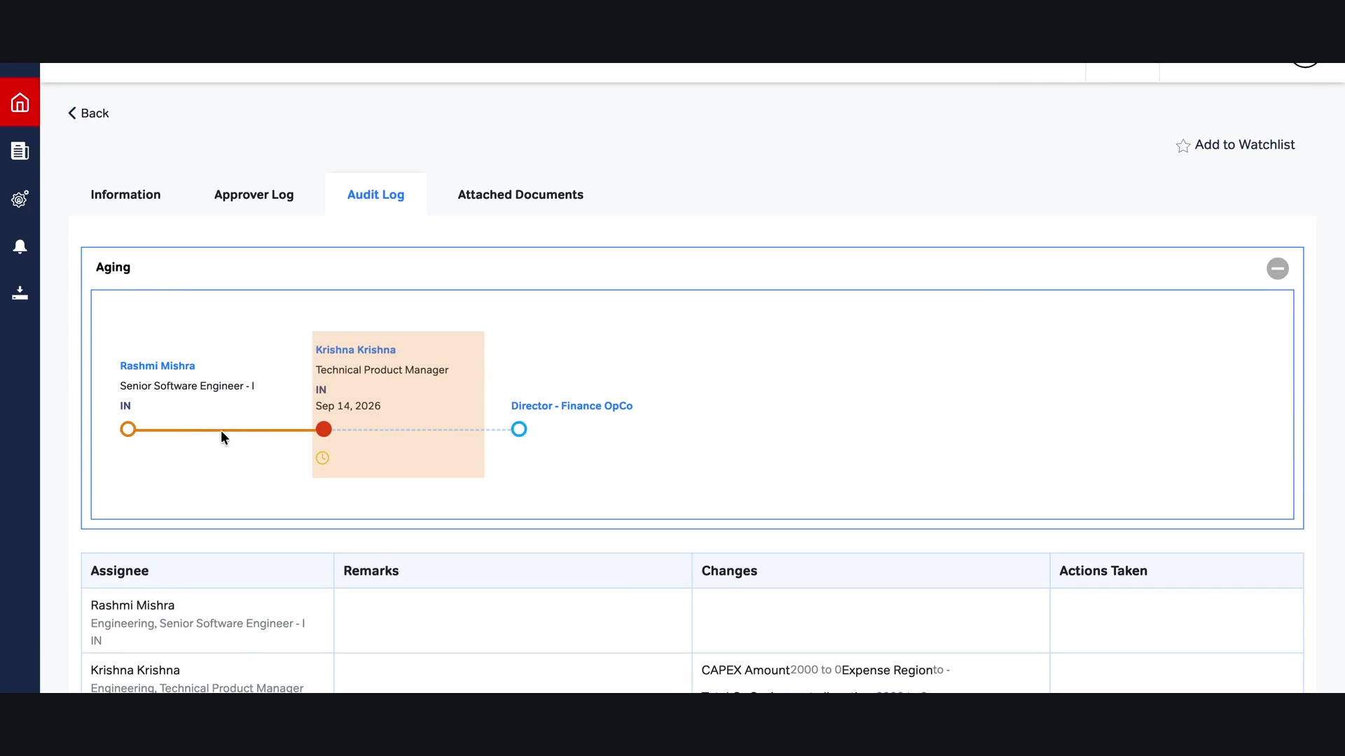
DOA Edit and Role Update

Slide 21

Roles Management

Slide 22
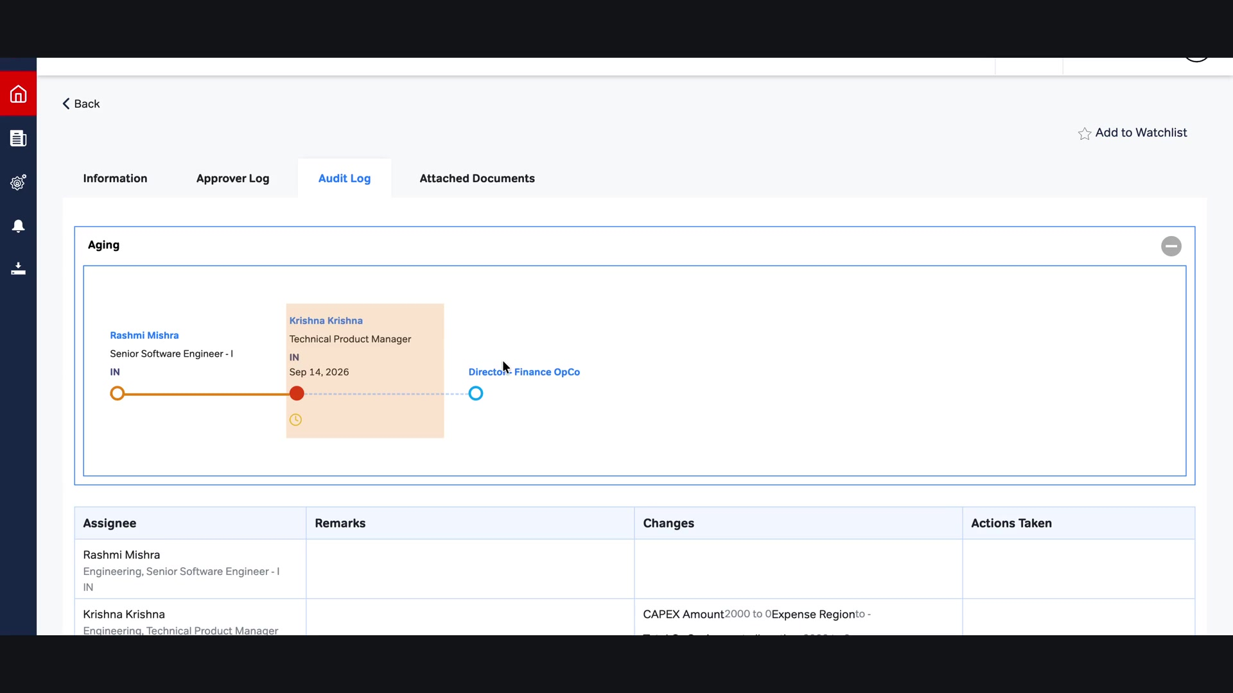
Probatus Process Form

Slide 23

Form Preview

Slide 24

Ticket Audit Trail

Slide 25

Audit Events

Slide 26
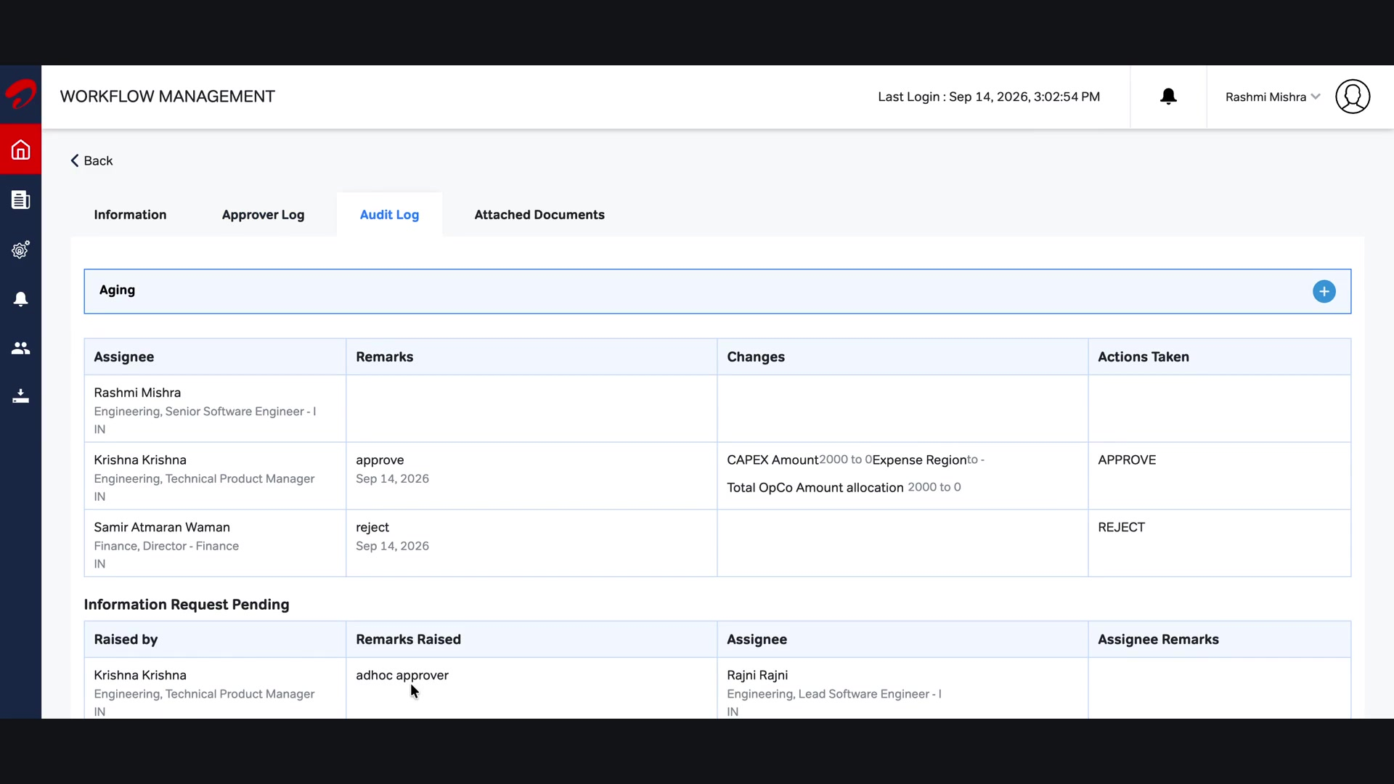
Form Download

Slide 27

Attached Evidence

